Slide 1

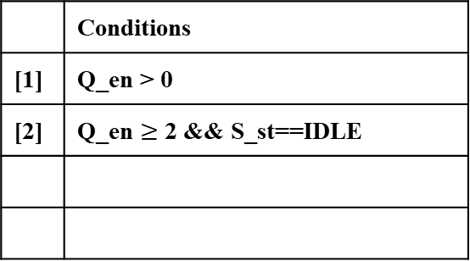

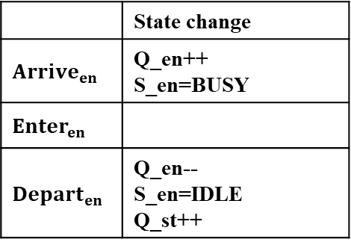


inter_t
 | State change
$${Arrive}_{en}$$ | Q_en++ S_en=BUSY
$${Enter}_{en}$$
$${Depart}_{en}$$ | Q_en-- S_en=IDLE Q_st++
[1]
Initial
$${Enter}_{en}$$
exe_t
$${Depart}_{en}$$
$${Enter}_{st}$$
$${Depart}_{st}$$
Report
[2]
[1]
 | Conditions
[1] | Q_en > 0
[2] | Q_en $≥$ 2 && S_st==IDLE

Slide 2
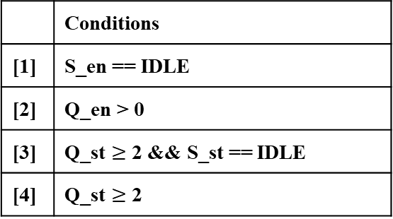







inter_t
Initial
$${Arrive}_{en}$$
$${Enter}_{en}$$
en_t
$${Depart}_{en}$$
[1]
 | State change
$${Arrive}_{en}$$ | Q_en ++
$${Enter}_{en}$$ | S_en = BUSY Q_en ––
$${Depart}_{en}$$ | S_en = IDLE
$${Arrive}_{st}$$ | Q_st ++
$${Enter}_{st}$$ | S_st = BUSY Q_st –= 2
$${Depart}_{st}$$ | S_st = IDLE
 | Conditions
[1] | S_en == IDLE
[2] | Q_en > 0
[3] | Q_st $≥$ 2 && S_st == IDLE
[4] | Q_st $≥$ 2
[2]
$${Arrive}_{st}$$
$${Enter}_{st}$$
st_t
$${Depart}_{st}$$
[3]
[4]

